Slide 1
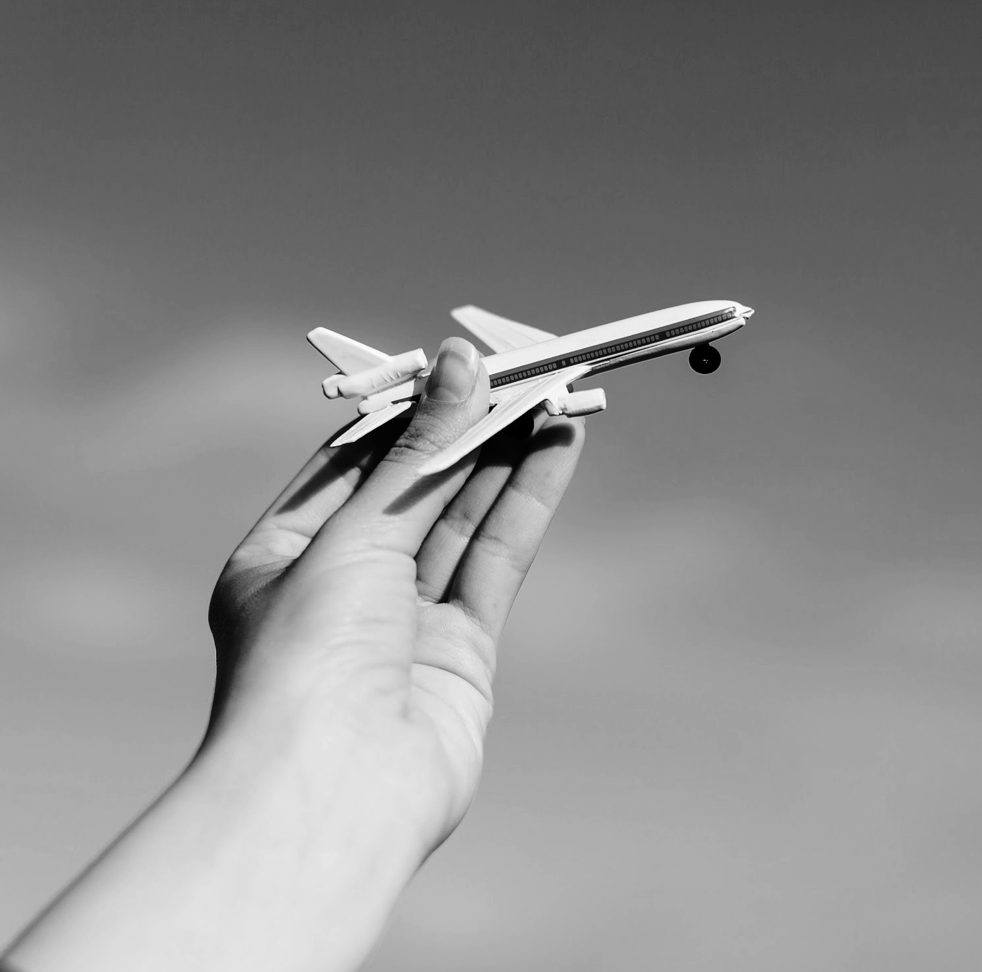
Teaching about the impact of transport on Ireland’s carbon emissions
A Microworld Simulation
BA Final Year Project
Michael Sweeney
Date 23/03/2023

Slide 2
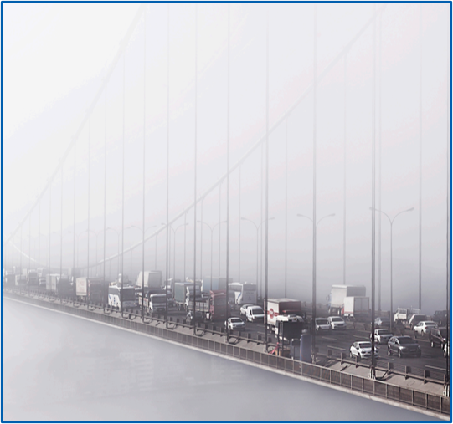
Problem Area
Climate change and sustainability are pressing global issues that require immediate action. Transportation is a major contributor to greenhouse gas emissions and air pollution, which exacerbates the effects of climate change. According to the International Energy Agency (IEA) (2019), the transport sector is responsible for around 23% of global energy-related CO2 emissions. In 2019, this equates to 2.8 billion tons of CO2 emissions worldwide. ​

Slide 3
Project Brief
Initial Goals
Education is a crucial tool in addressing these issues and raising awareness among the public. The lack of understanding and awareness of these issues, particularly by students, is a significant barrier to achieving sustainable transportation. However, by providing an interactive microworld, learners can gain a deeper understanding of the impact of their transportation choices.
Microworld Goals
Target Audience:
The initial goal was to make it user-friendly for Bridge2College students
Impact:
Promote greater awareness and engagement on the issue and encourage individuals to make more sustainable transportation choices
Development:
Develop and evaluate the use of a website that contains a multi-step microworld that accurately represents the impact of transportation on the environment.

Slide 4
>90%[2]
Currently, over 90% of the global transport sector relies on fossil fuels with 49% of oil production consumed in the transport sector! That’s only a 3% decrease since 1970!

Slide 5
40%
of energy-related CO2 emissions comes from transport in Ireland that’s twice double the share of electricity! Which equates to ~20% of the country’s total CO2 emissions.

Slide 6
54%[3]
95%[4]
of Ireland’s transport emissions
Of Ireland’s transport emissions
of Ireland’s transport emissions
come from passenger cars
come from road transport
47,000[5]
-26%[6]
Electric Cars in Ireland
Reduction in 2020
The number of electric vehicles doubled from 2020 to 2021 but only reached <5% of Ireland’s 2030 goal of 945,000 vehicles
In Ireland, transport energy emissions were reduced by 26% due to Covid-19 restrictions

Slide 7
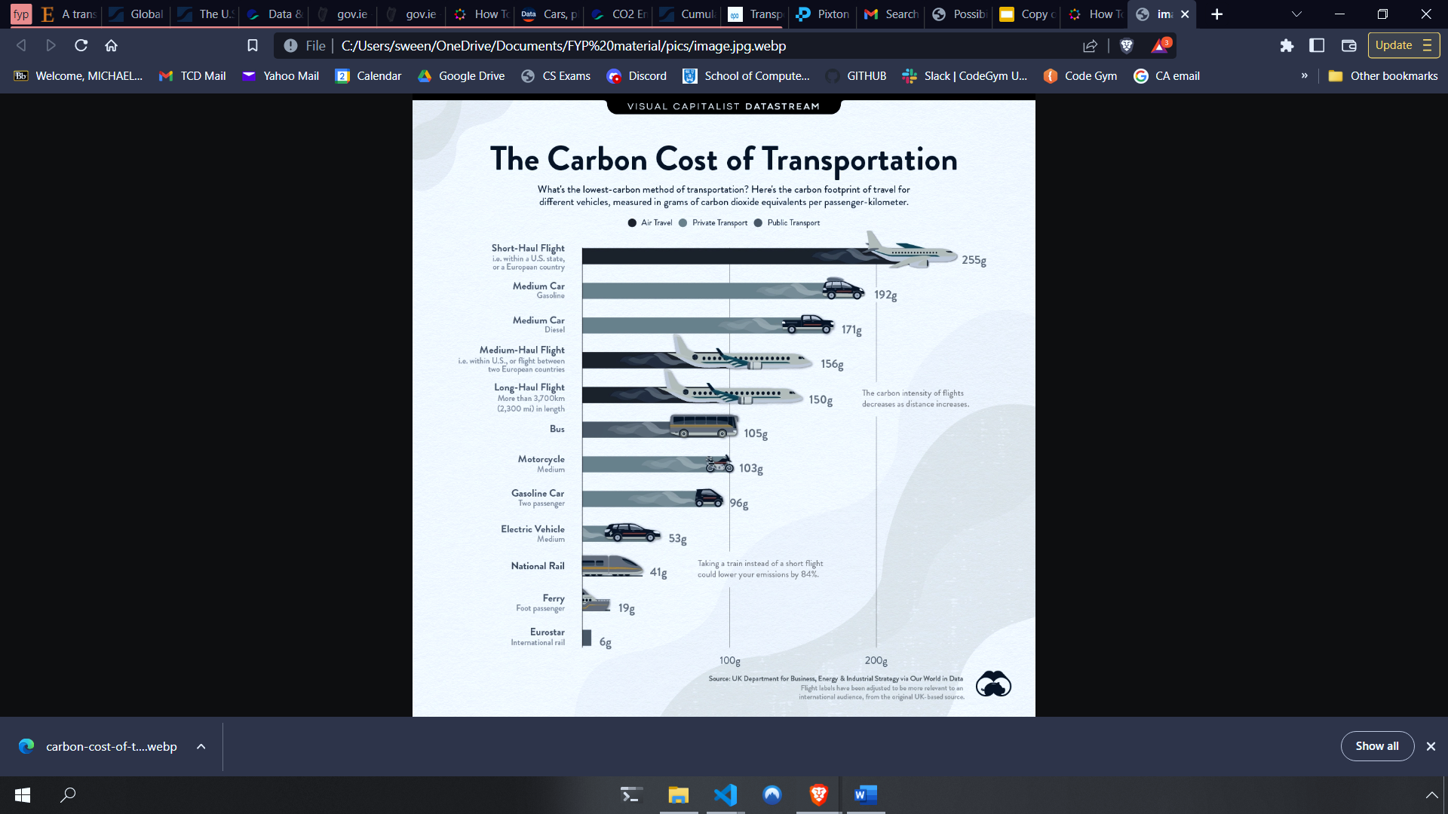
The Cost?
We can see that excluding short-haul flights, personal cars are the most carbon-intensive transport option [7]

Slide 8
Ireland aims for a 50% transport carbon emission reduction for 2030 [8]
I created a microworld with this goal in mind. By motivating students to half their transport emissions we can get a head start on what sacrifices are needed to reach our goals.

Slide 9
The Microworld will help learners to
1
2
3
Understand
Visualize
Decide
Start by reading through the data and statistics to get an idea of our impact on the world
Discuss and input their normal yearly transport decisions
Make future decisions on how to cut back on their yearly emissions

Slide 10
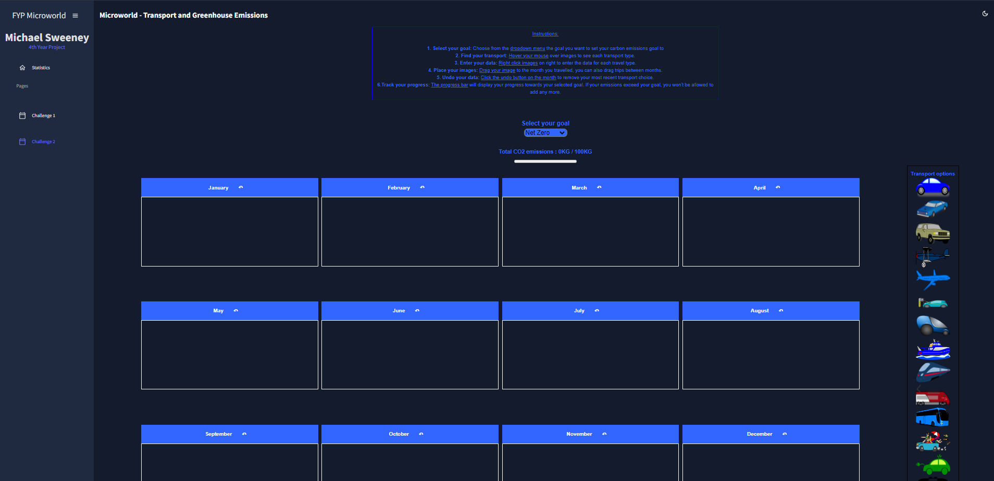
User Interface/Design

Slide 11





Technical Architecture
Calculating Emissions = KM * Frequency * CO2 emissions per KM

Slide 12
Microworld Demo

Slide 13
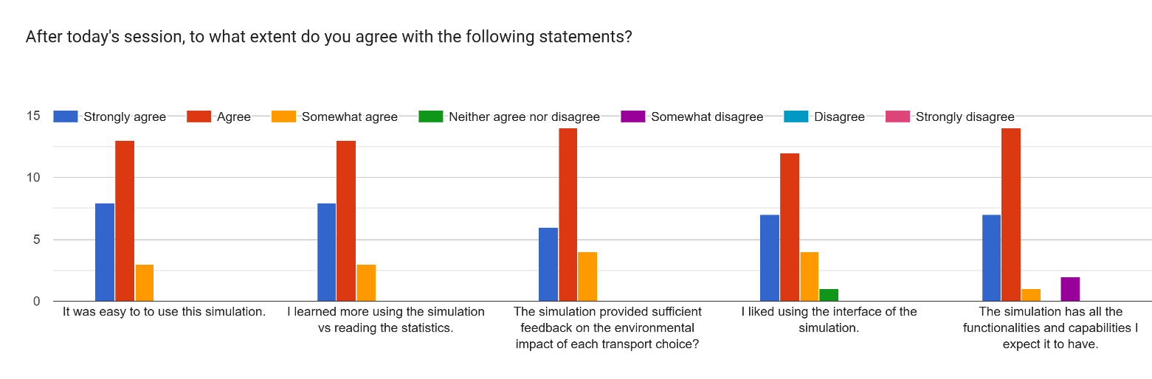
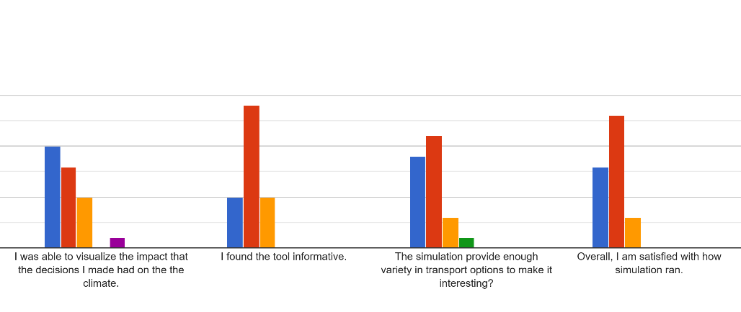
Evaluation
Usability evaluation
The feedback on the usability of the microworld was very positive. However, some feedback suggests that the website needs to be more user-friendly for older students. Some specific suggestions include changing the interface, improving the colour scheme, icons of travel options and displaying emissions raised after each input with a popup.
Students considered the tool to be unique and beneficial, especially for classrooms; but said it might need some adjustments to engage more young people and raise awareness effectively.

Slide 14
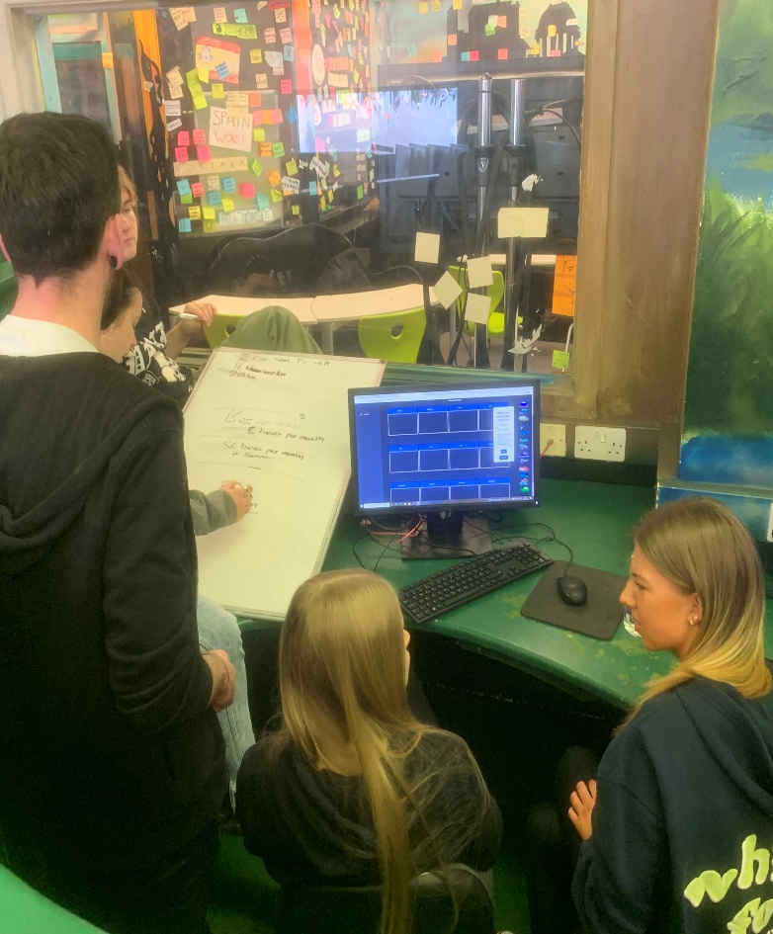
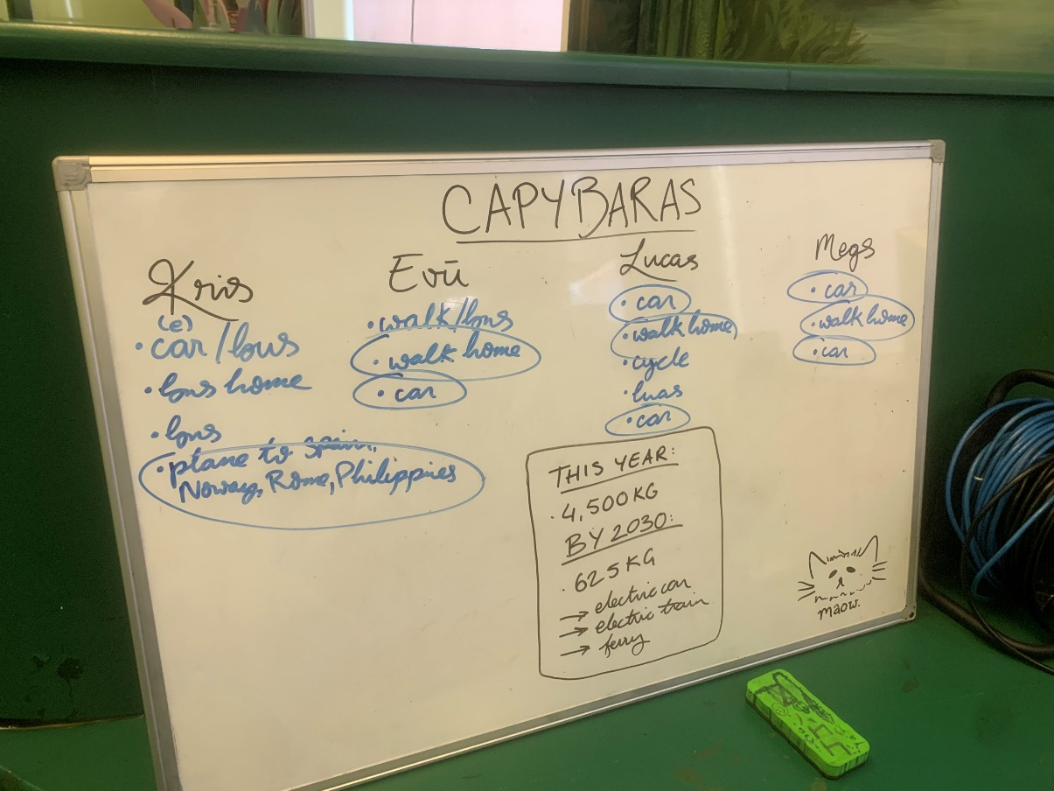
Bridge2College: Challenge 1
Initial reactions from the students
In a collaborative effort, students gathered in groups and engaged in discussions about their annual transportation habits. Through this process, they were encouraged to work together and take an average of their group's habits to use as a reference point for Challenge 1. This allowed them to gain a better understanding of where their individual transportation emissions stood in comparison to the national average, emphasizing the importance of collective action towards a more sustainable future.

Slide 15
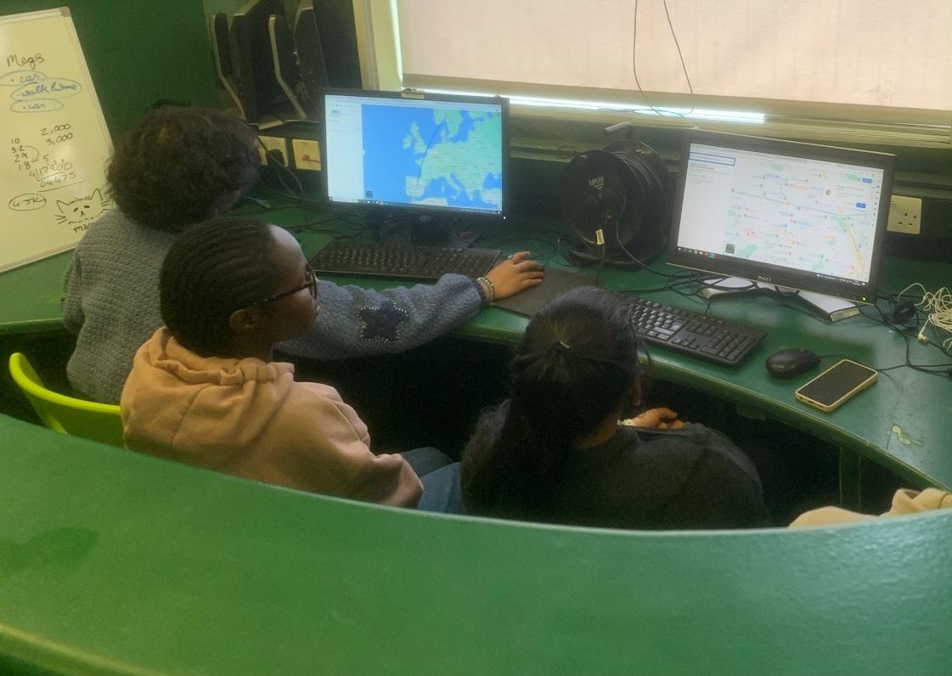
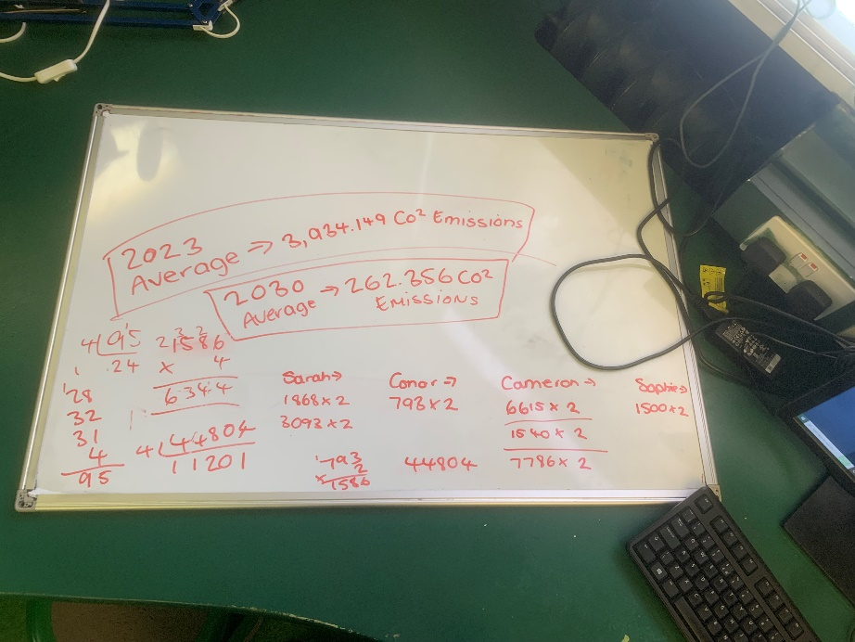
Bridge2College: Challenge 2
In the second challenge, students were tasked with adjusting their transport habits from the year 2023 and choosing more environmentally friendly options to reach 2030 goals. It was encouraging to see that many students opted for closer holiday destinations and the purchase of electric vehicles. Notably, a particularly interesting takeaway was that a majority of students indicated a willingness to choose journeys that involved ferries and public transport instead of flights to nearby countries. This highlights a growing awareness of sustainable transportation options and a willingness to make changes that benefit the environment.

Slide 16
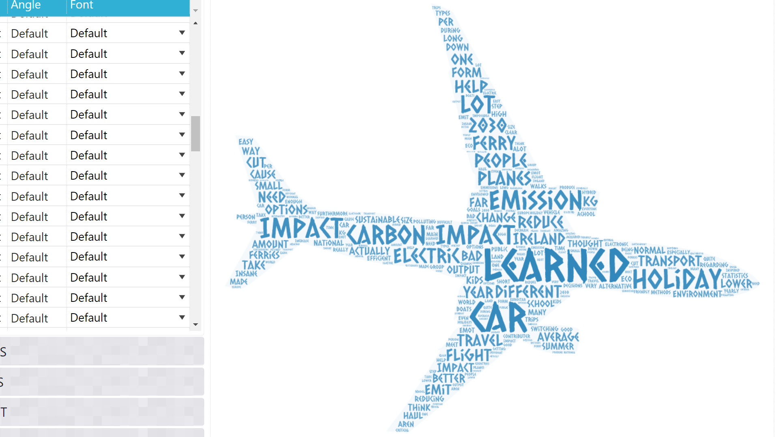
Feedback from the students
“Being sustainable and eco-friendly is not as difficult and impossible as everyone makes it to be. Take it one step at a time and you will make a difference.”
“I learned about how my decisions impacted the world, the different amounts of carbon emissions people use and how I can reduce the amount I use.”

Slide 17
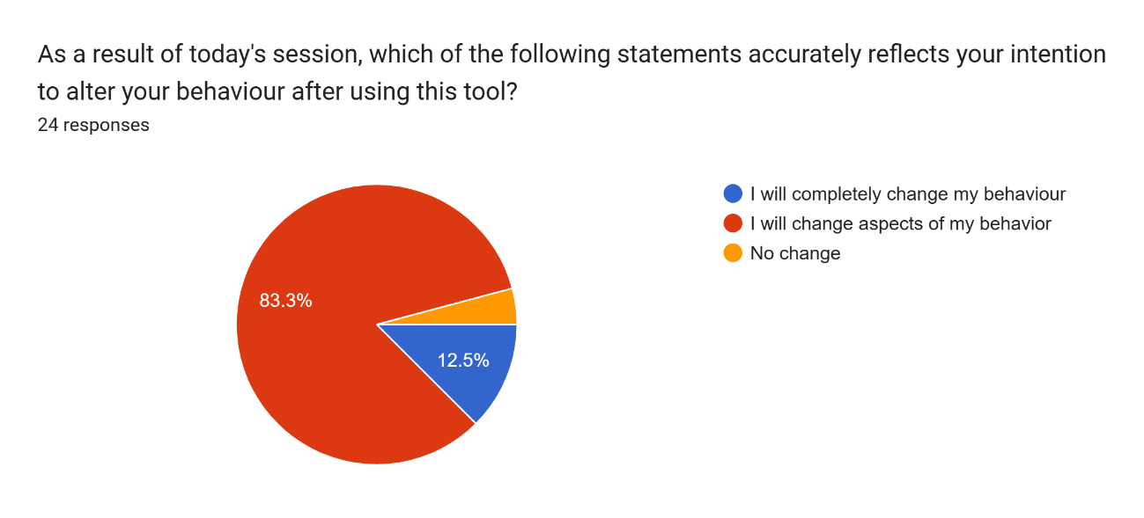
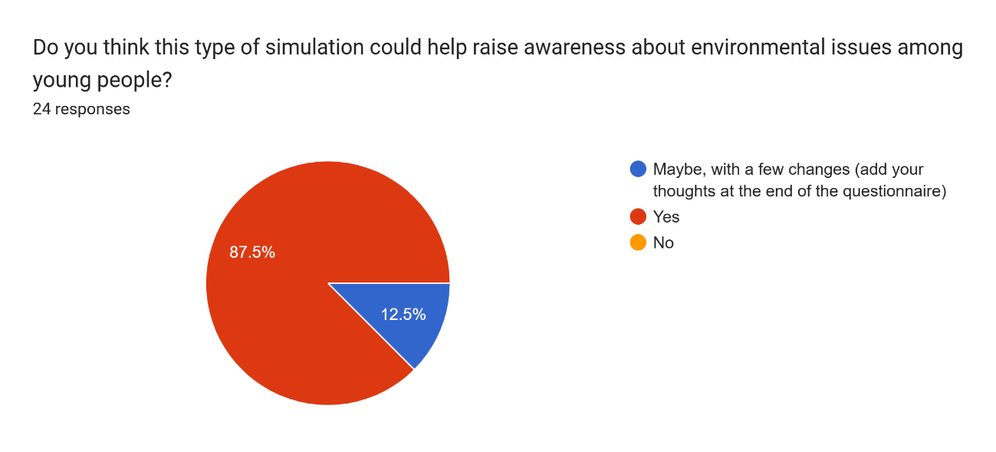
Impact of the Simulation
The results of the study were overwhelmingly positive, as a majority of the students who participated expressed a willingness to modify their behaviour after using the Microworld. Additionally, they believed that the Microworld had the potential to increase awareness about environmental issues among young people.

Slide 18
Challenges Overcome
One of the main challenges of the project was to accurately represent the impact of transportation on the environment while providing a fun and interactive experience for users.
The project also faced technical challenges such as learning new technologies and dealing with bugs that required rebuilding the entire microworld from scratch in the final weeks.
Motivating the students to make a change as we don’t have many alternative options in Ireland.

Slide 19
Summary
In conclusion, the project aimed to educate users about the impact of transport on Ireland's carbon emissions through an interactive Microworld simulation. The simulation allowed users to explore the effects of different modes of transport on carbon emissions and provided insights into the environmental impact of transport on Ireland. The reactions from the students were very positive, this suggests that the Microworld simulation was effective in achieving its educational objectives and has the potential to inspire positive changes in behaviour towards sustainable transportation in Ireland.

Slide 20
40%[2]
Resources
[1]https://www.iea.org/reports/global-energy-review-co2-emissions-in-2021-2
[2]https://www.iea.org/reports/global-energy-review-co2-emissions-in-2021-2
[3]https://www.epa.ie/our-services/monitoring--assessment/climate-change/ghg/transport/
[4]https://www.epa.ie/our-services/monitoring--assessment/climate-change/ghg/transport/
[5]https://www.epa.ie/our-services/monitoring--assessment/climate-change/ghg/transport/
[6]https://www.epa.ie/our-services/monitoring--assessment/climate-change/ghg/transport/
[7](UK Department For Business, Energy and Industrial Strategy via Our World In Data)
[8]https://www.gov.ie/en/publication/a7386-sd-test-climate-action-transport/

